Slide 2
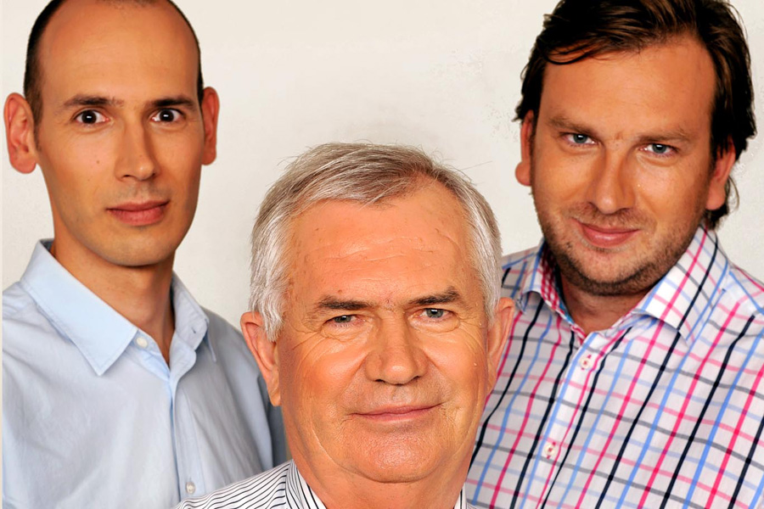
Who we are?
Managing directors Mr. Péter Szabó Mr. Ákos Szabó
Gallus Group owned by Hungarian families
Key market player in Hungary in the poultry industry
Includes 12 companies
Includes 36 locations in West-Hungary
125 MEur annual sales
1100 employees
Main activities :
Broiler rearing
Hatching egg production
Hatchery
Feed production
Slaughterhouse
Mr. István Szabó
Founder
„Our vision is to strengthen our market position and improve the Hungarian agriculture to get back to it’s leader position in East-European region„

Slide 3
Full vertical integration within the Group

Slide 4
Gallus Ltd.
Feed production
Breeder farms
Hatchery

Slide 5
Taravis td.
Broiler rearing
Slaughterhouse Production
Slaughterhouse Packaging

Slide 6
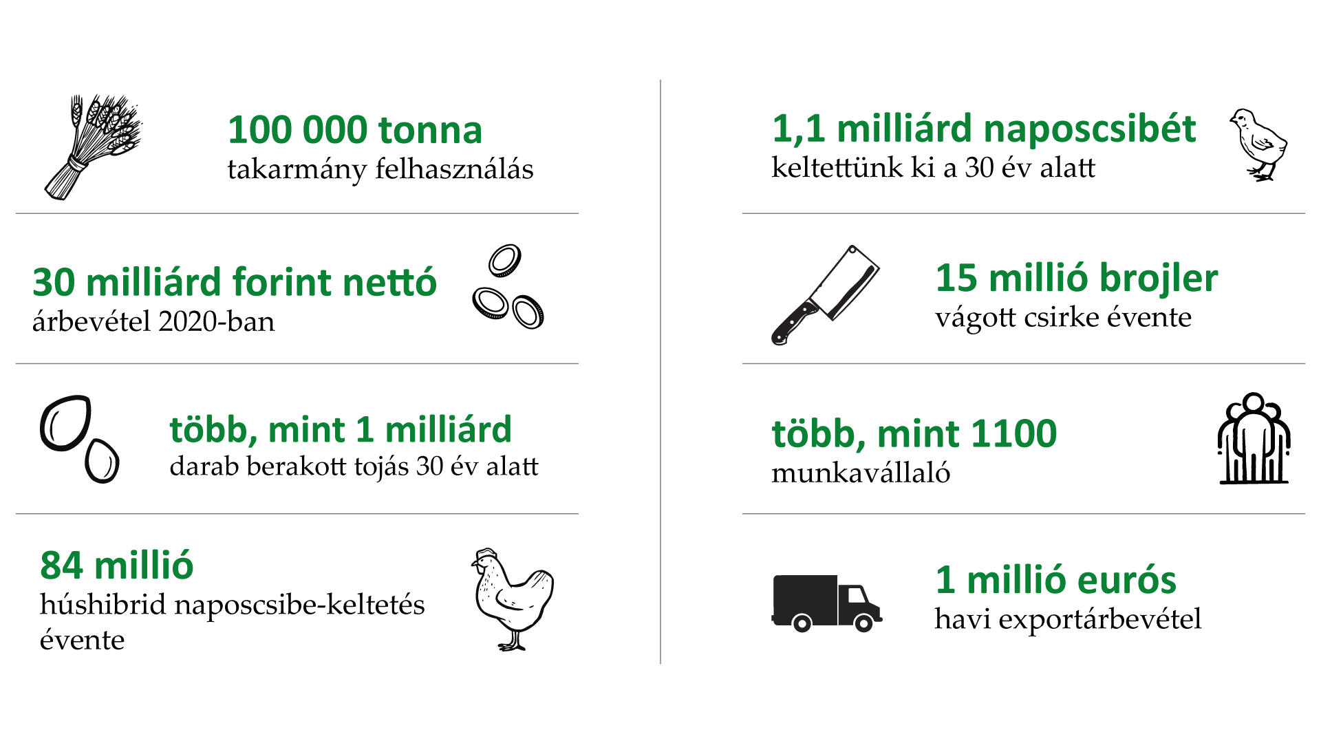
Our key figures
100 000 t feed consumed
1.1 billion day old chicken over the last 30 years
30 billion HUF sales in 2020
15 million broiler produced in a year in our slaughterhouse
More than 1 billion egg produced over the last 30 years
More than 1100 engaged employee
100 million day old chicken produced in a year
1 million Euro export sales in a month

Slide 7
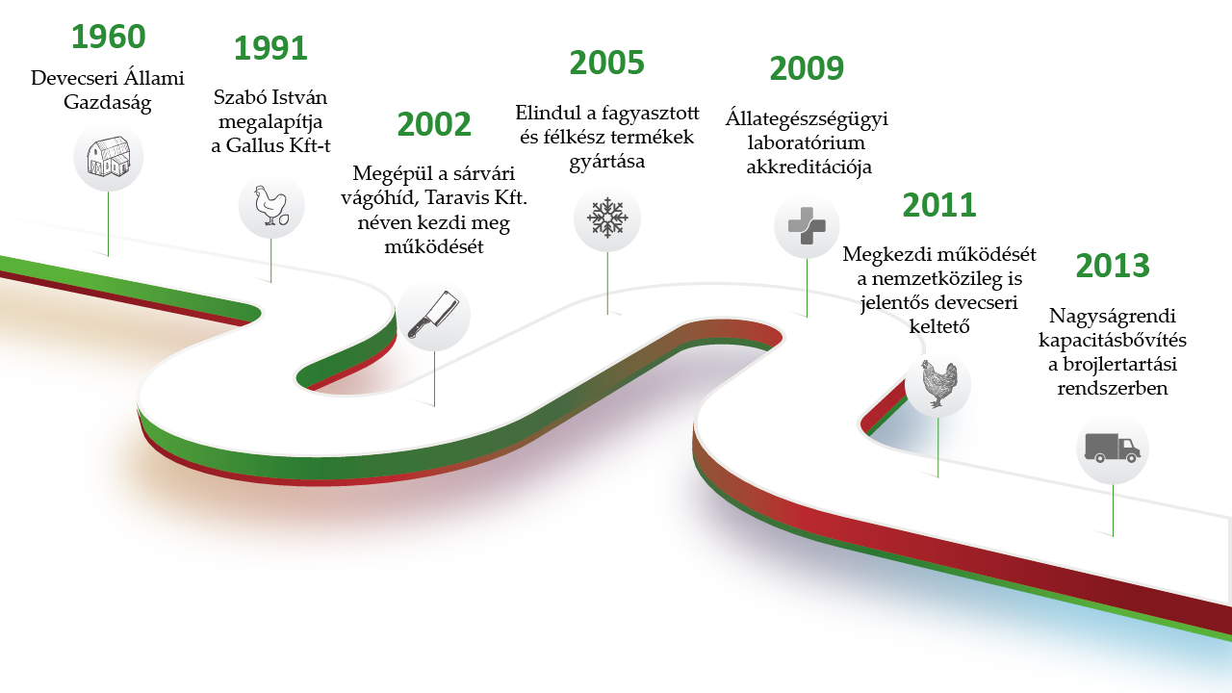
Milestones in our History I.
First Farm in Devecser
Gallus Ltd founded
Freezed & semi finished products
Certified Laboratory in Devecser
Slaughterhouse in Sarvar
Capa extension in Devecser Hatchery
Capa extension in Broiler rearing

Slide 8
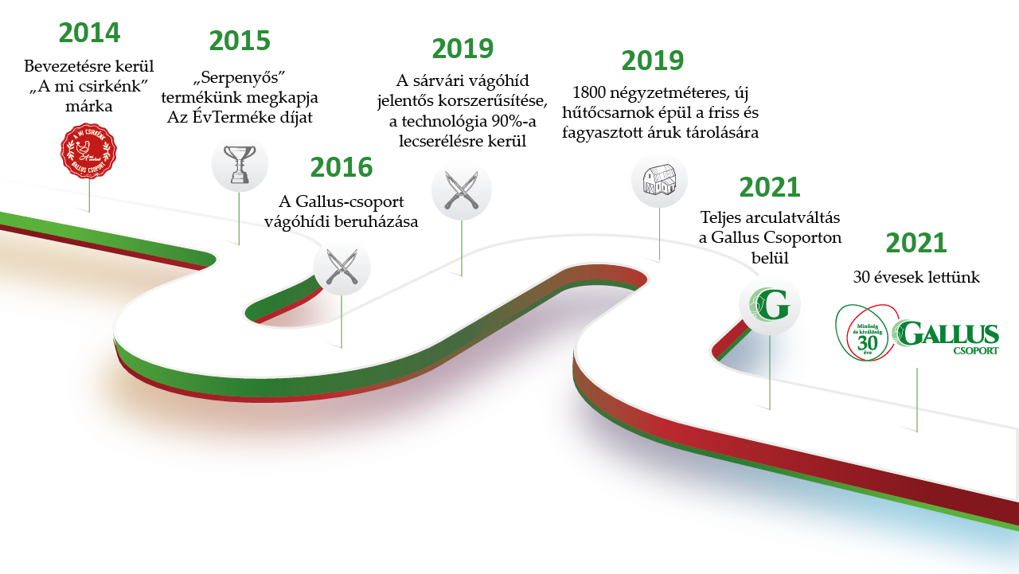
Milestones in our History II.
New Brand
„Our own chicken”
Product of the year award
Automatized technology in the slaughterhouse
Cooled warehouse for freezed products
Slaughterhouse invest
New image for the entire Gallus Group
30 years anniversary

Slide 9
The Beginnings
1960’s
New farm founded by the Hungarian State in Bakonypölöske specialized for poultry industry
1987
New hatchery founded in Devecser, which is – thanks to the continuous improvement- includes the best technology in Hungary.

Slide 10
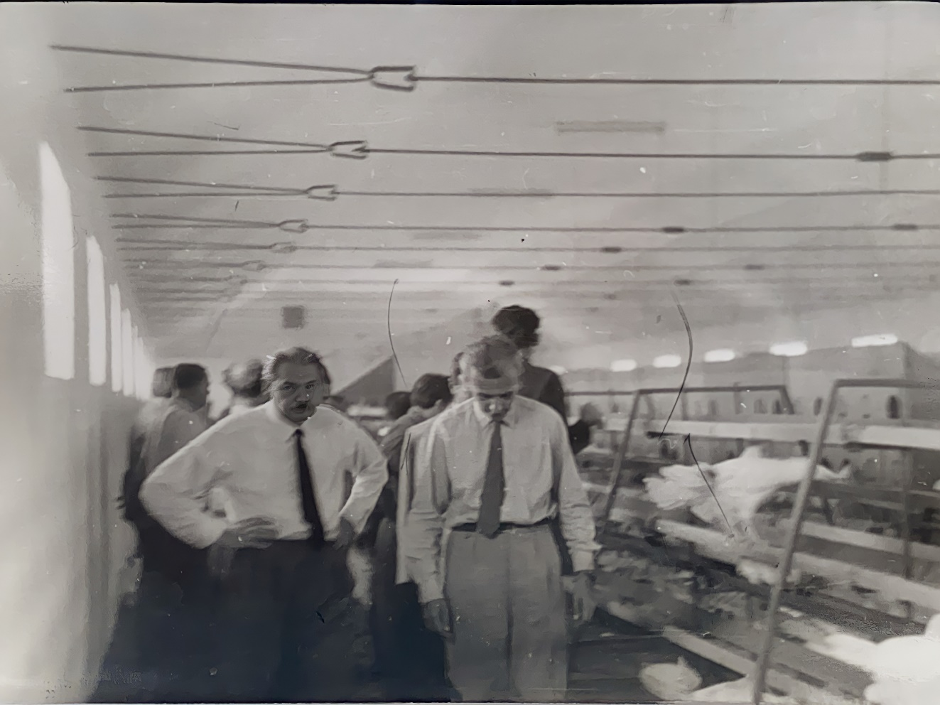
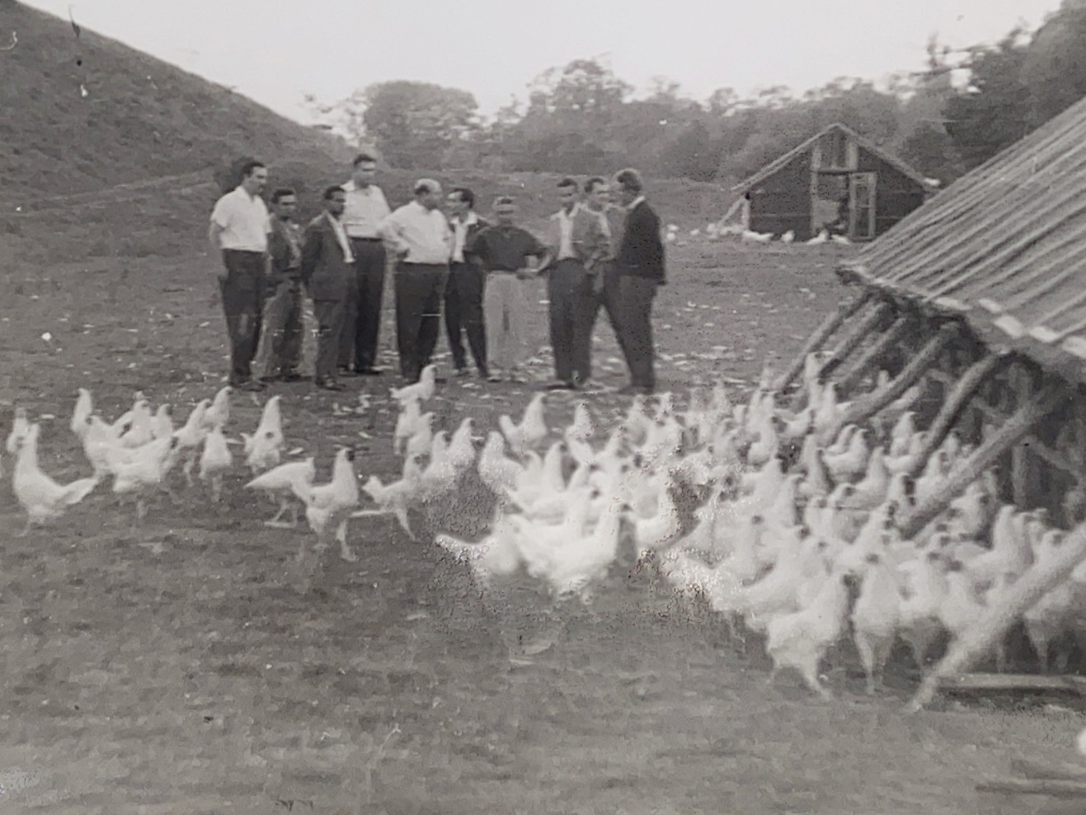

Slide 11
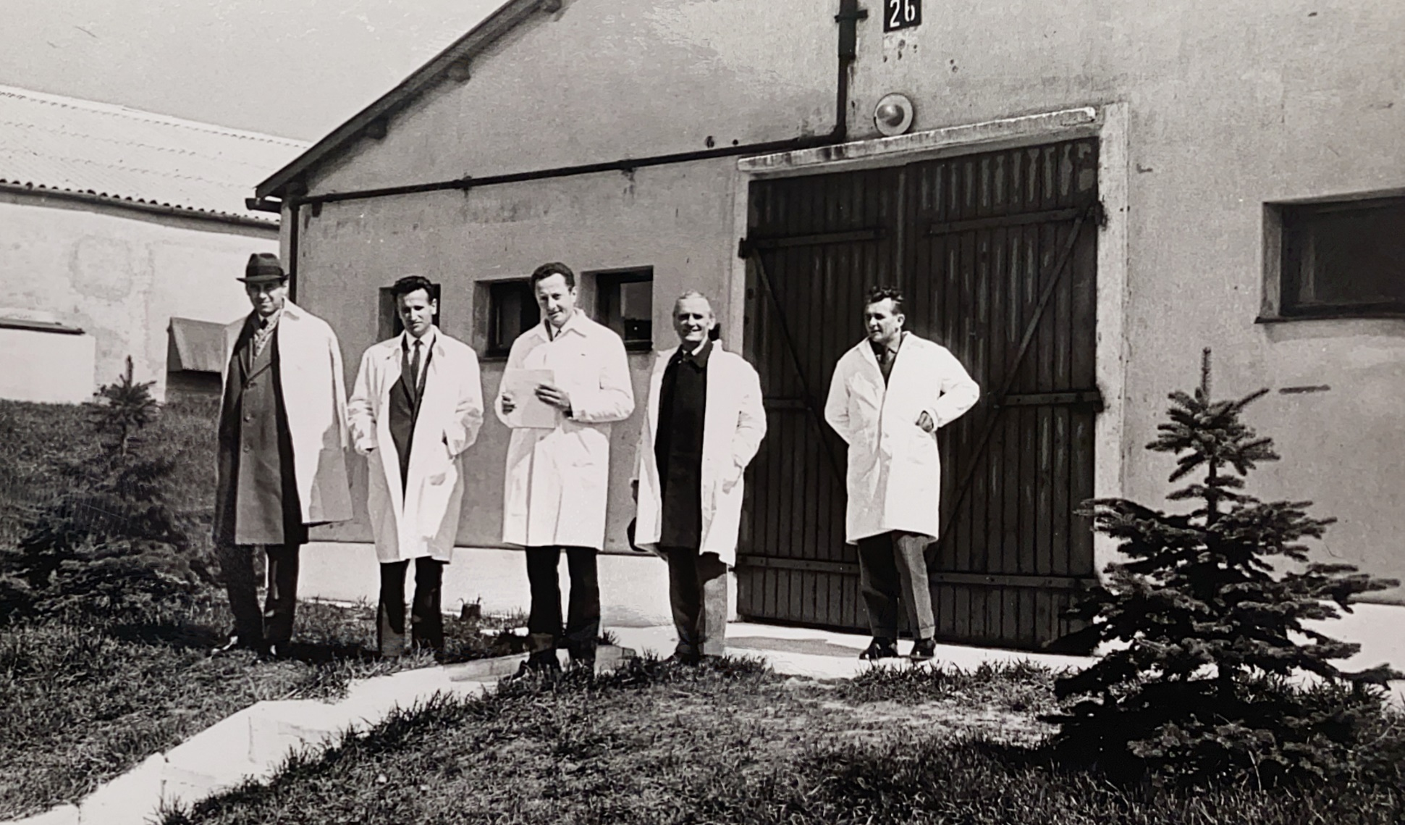
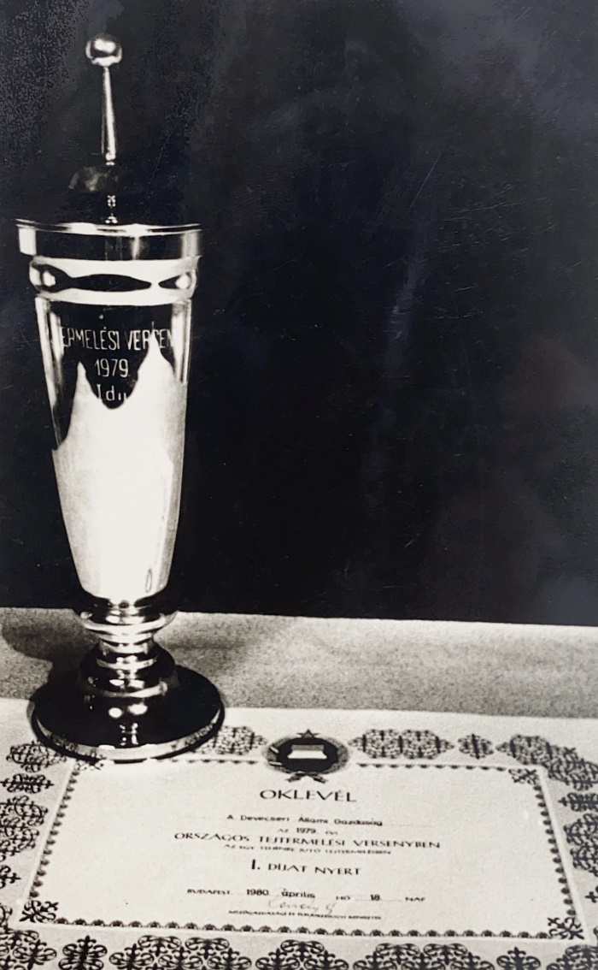
Flashbacks of the memories in pictures

Slide 12
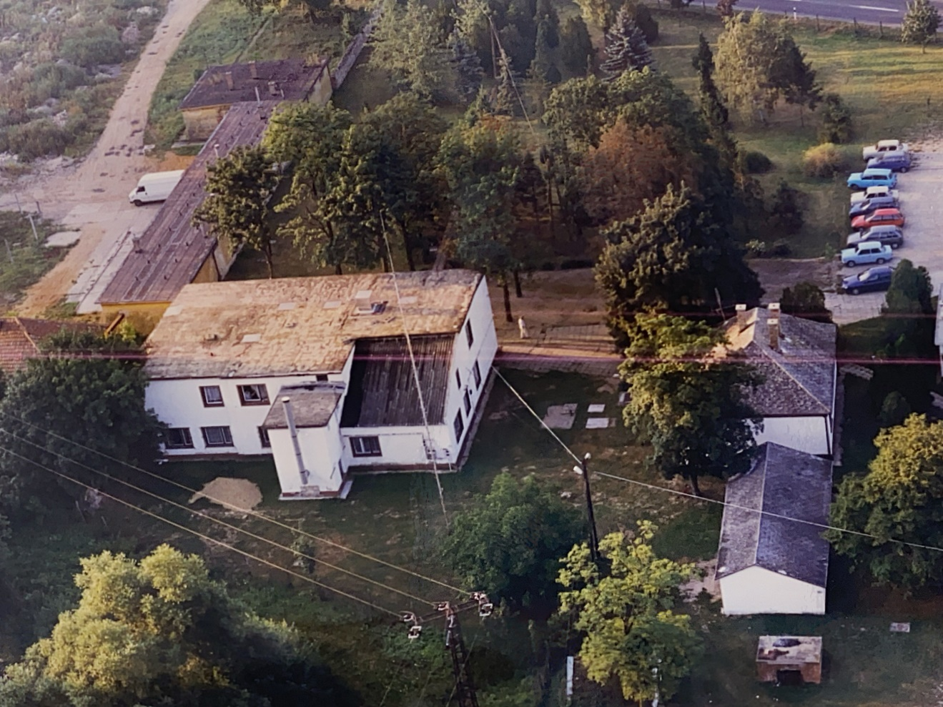
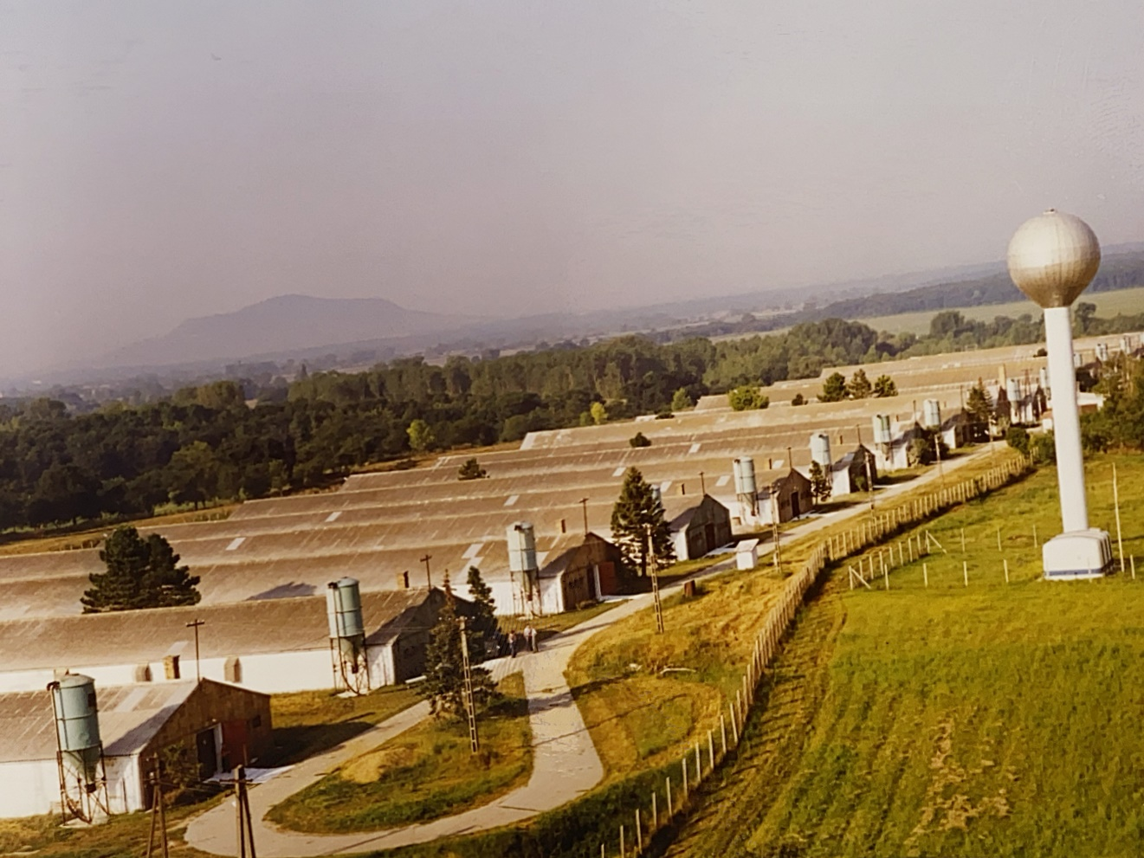
Flashbacks of the memories in pictures

Slide 13
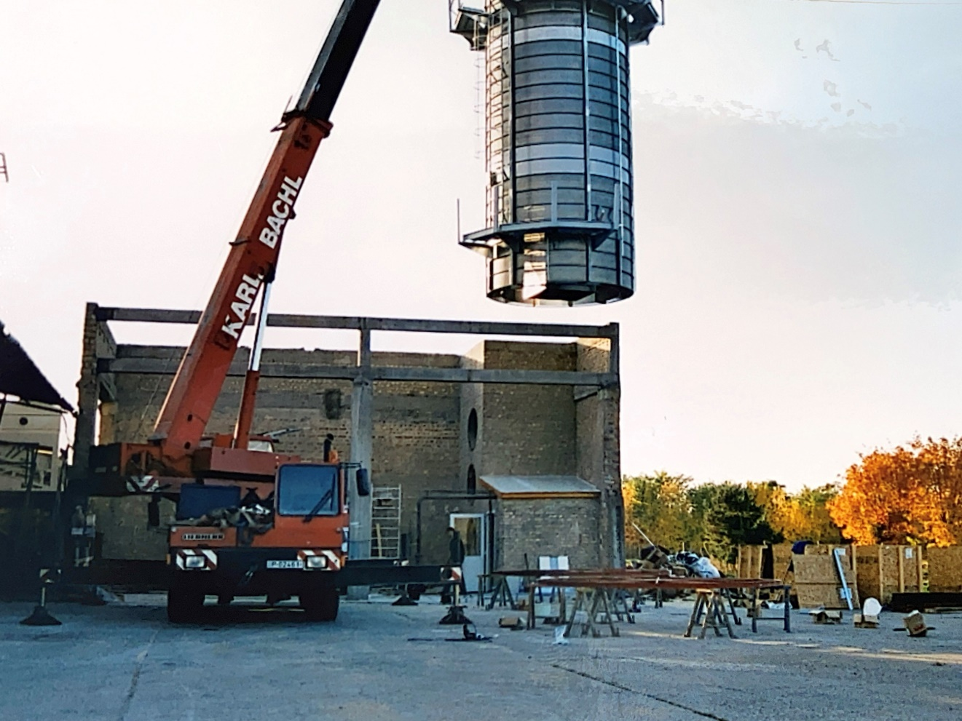
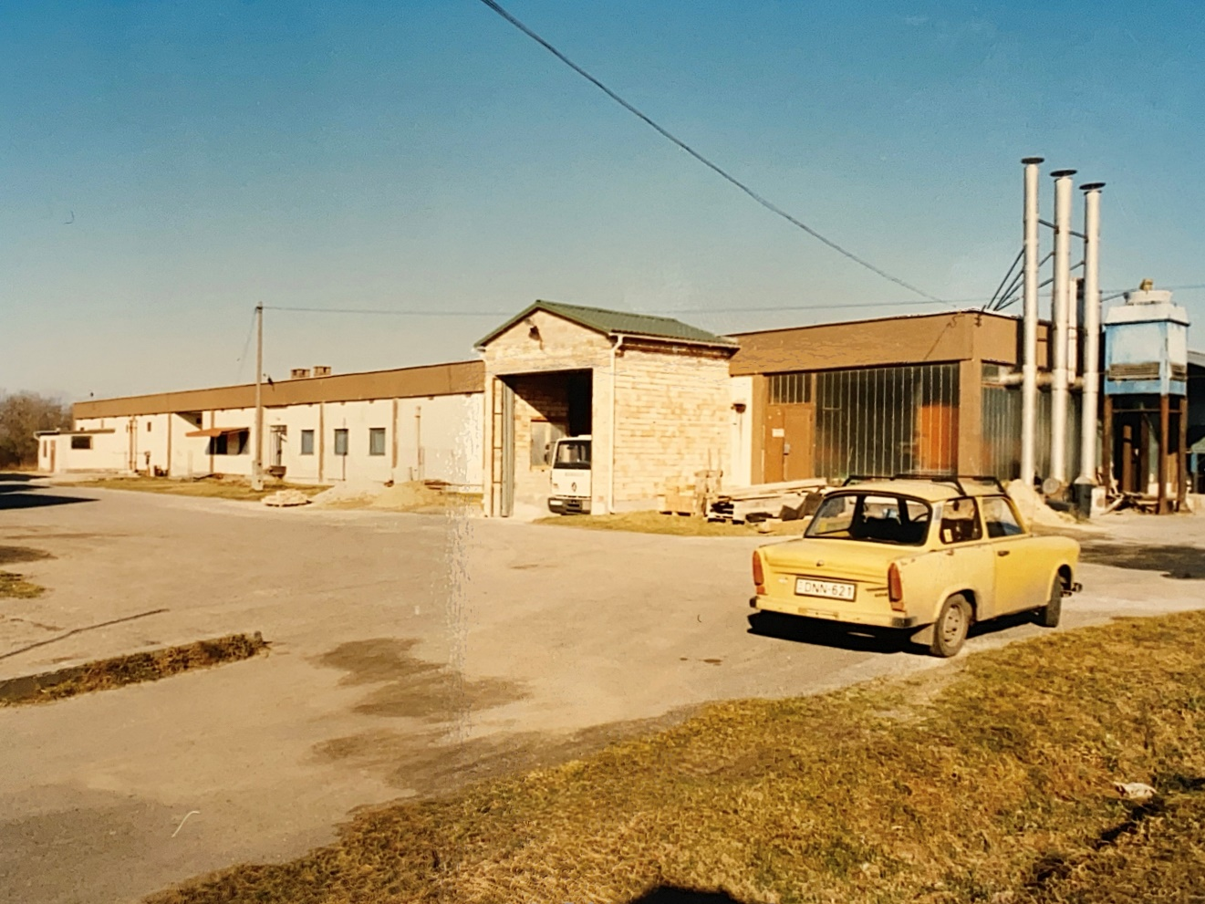
Flashbacks of the memories in pictures

Slide 14
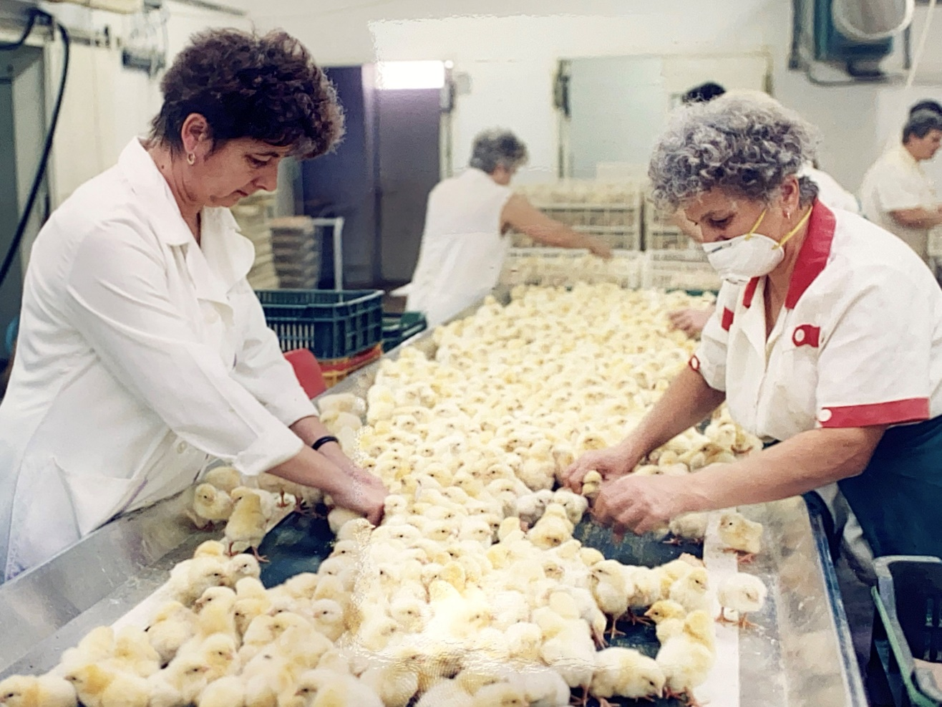
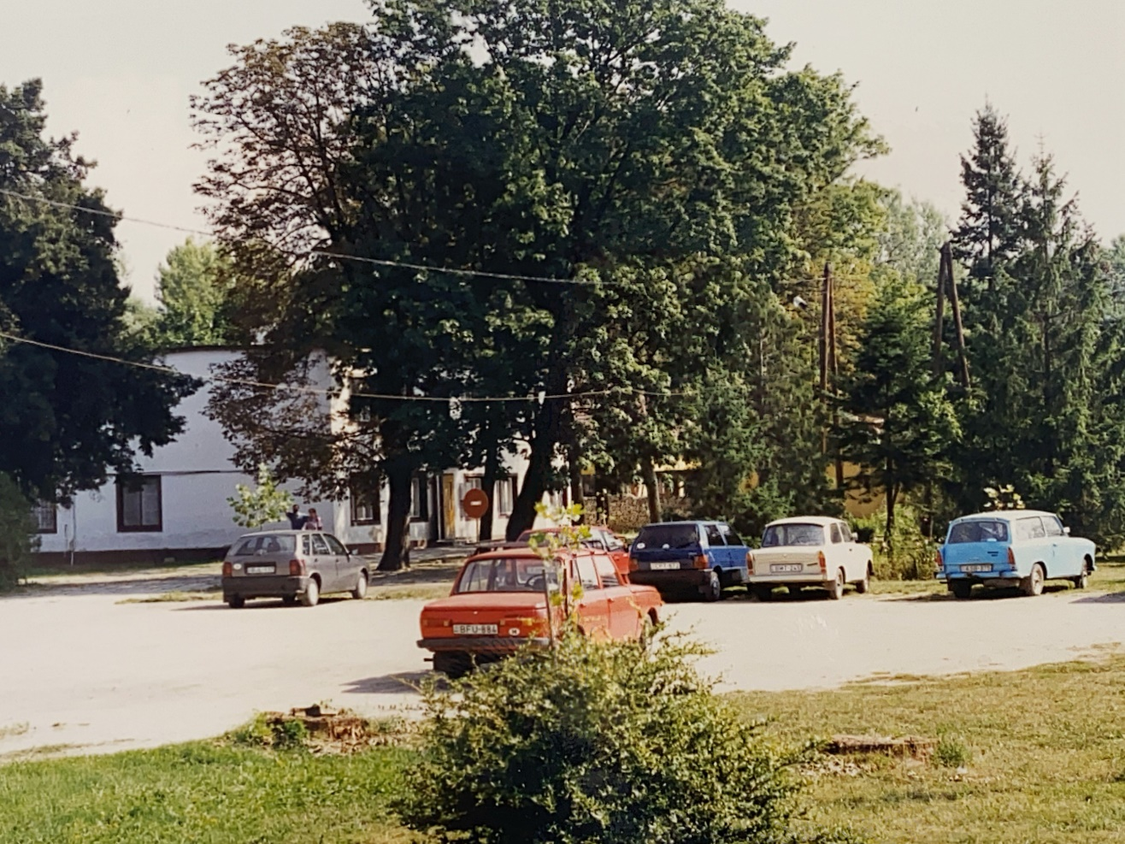
Flashbacks of the memories in pictures

Slide 15
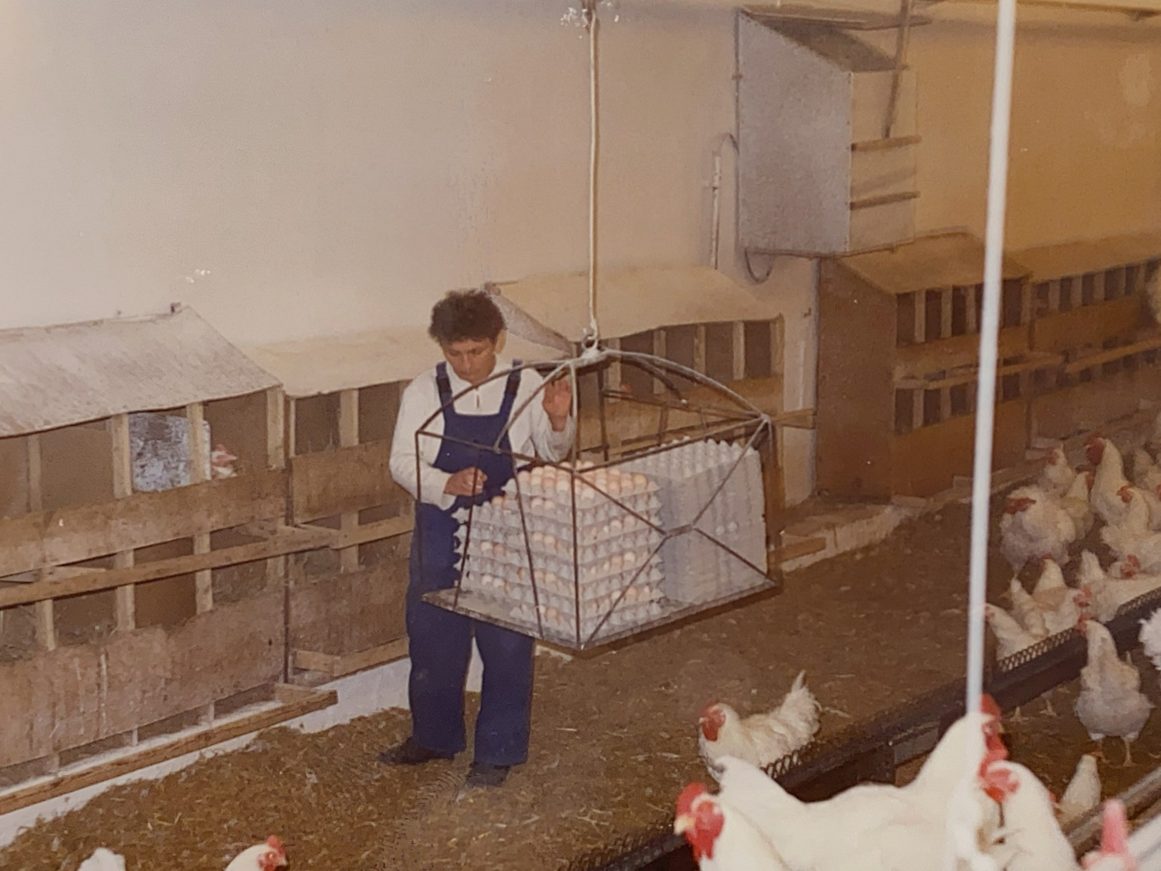
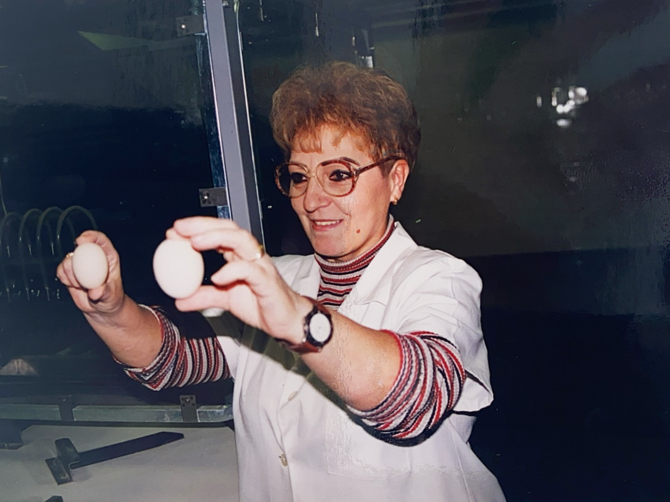
Flashbacks of the memories in pictures

Slide 16
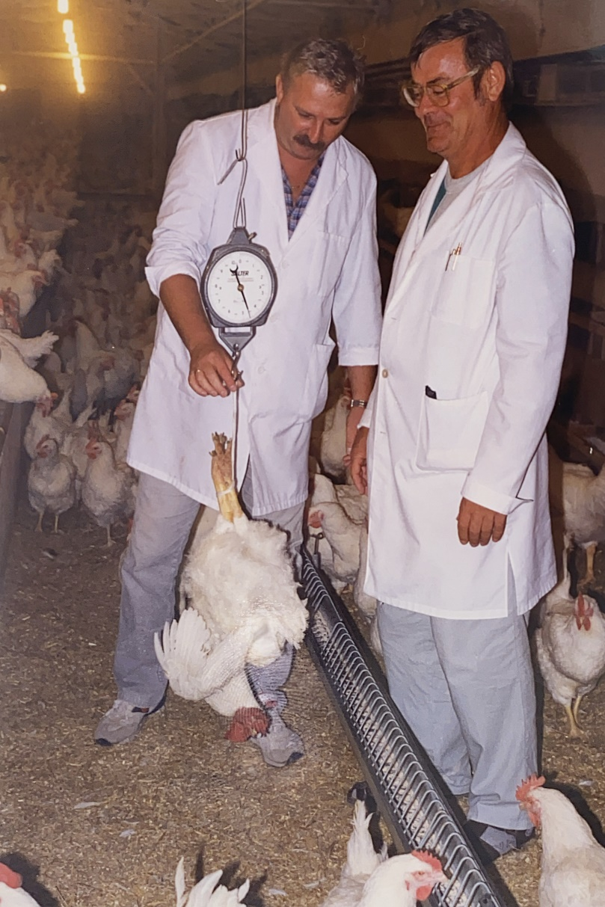
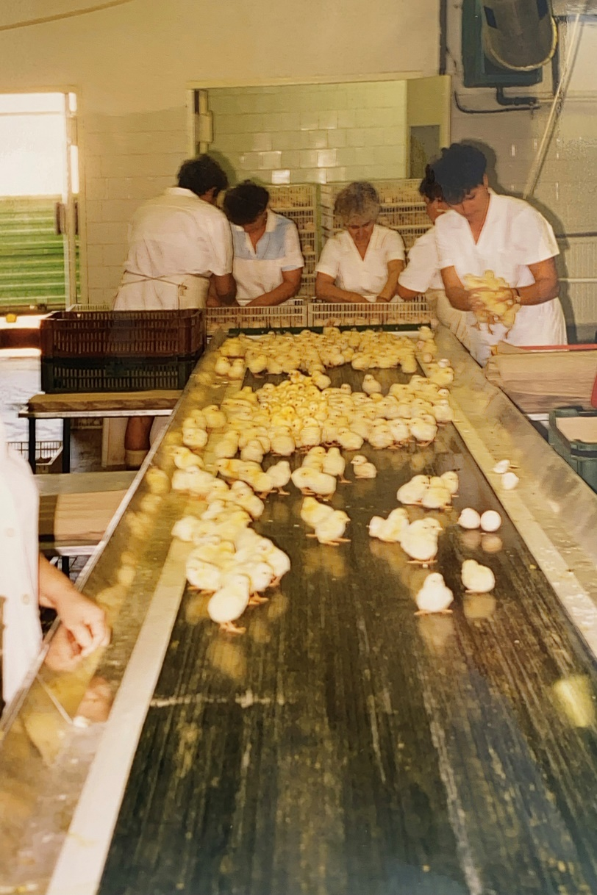
Flashbacks of the memories in pictures

Slide 17
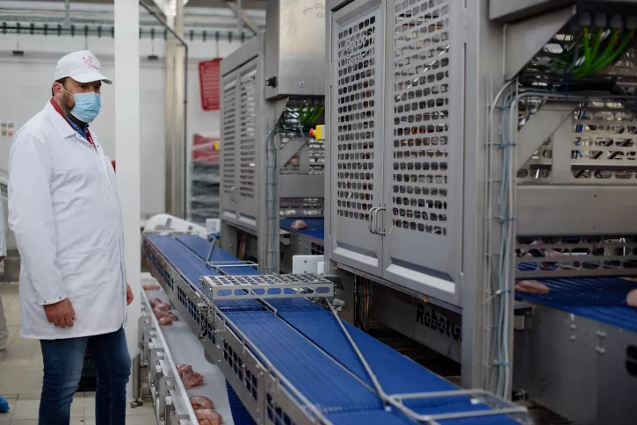
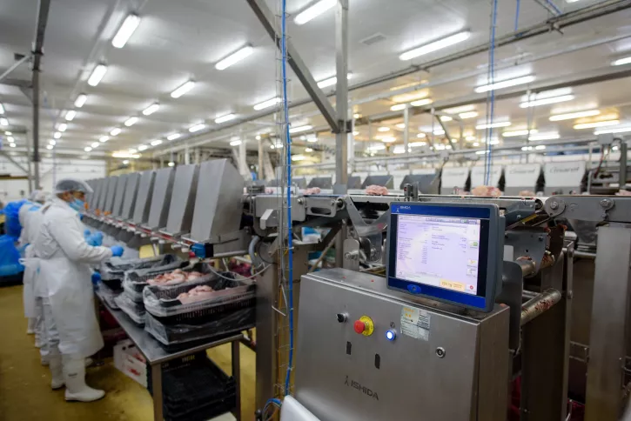
Continuous Improvements, Innovation
Over the years our technologies were continuously improved in order to increase our efficiency, reduce our energy consumptions, and improve the quality of our products. In the vertical integration we use everywhere state of the art automatized machines to be always one step ahead compared to our competitors and ensure our customers satisfaction.

Slide 18
Renewal in progress since 2021
Restructure the group to be more in line with the future expectations.
New image, reestablished base values, new communication.
Employer branding started, on the top of the high attention on the teamwork, special focus on our employees to support them in their professional grow.

Slide 19
Our market position
Today we are one of the most significant supplier for several retail chains in Hungary.
Our main customers are:
However we have wide range of customer defined products we are continuously working on the extension of our own brand product portfolio as well.

Slide 20
The brand – „Our own chicken”
9 times awarded by Superbrands award
Fresh products:
Shield gas packaging
Vacuum foil packaging
Foil packaging
Mass package
Ready to use products:
Grill products
Several spices
Chicken burger
Chicken rib

Slide 21
Poultry industry trend
Our customer demands for our slaughterhouse increased significantly since 2019. The normal annual growing was overran by more than 100%.
The outlook for the global poultry industry in the fourth quarter of 2022 and early 2023 remains strong, despite significant challenges in global poultry farming.
From a market perspective, a weaker economic climate with pressure on purchasing power will lead to more price-driven consumer behavior, supporting poultry consumption as it is the cheapest meat protein option.

Slide 22
Our Vision, Mission, Future
With our continuous improvements we invest in our future. We are not just simple react to the changing market demands, but in a proactive way we offer new solution to our customers.
We have a defined way to improve our efficiency, focus on the animal welfare, support the professional grow of our employees. As a result of these the Gallus Group will stay a key market player for the next 30 years inland and abroad in the poultry segment.
With our outstanding quality we are a stabile point for our customers and partners. Each and every day we are working onit to further increase their trust in the Gallus Group.

Slide 23
Thank you for your attention

