Slide 15
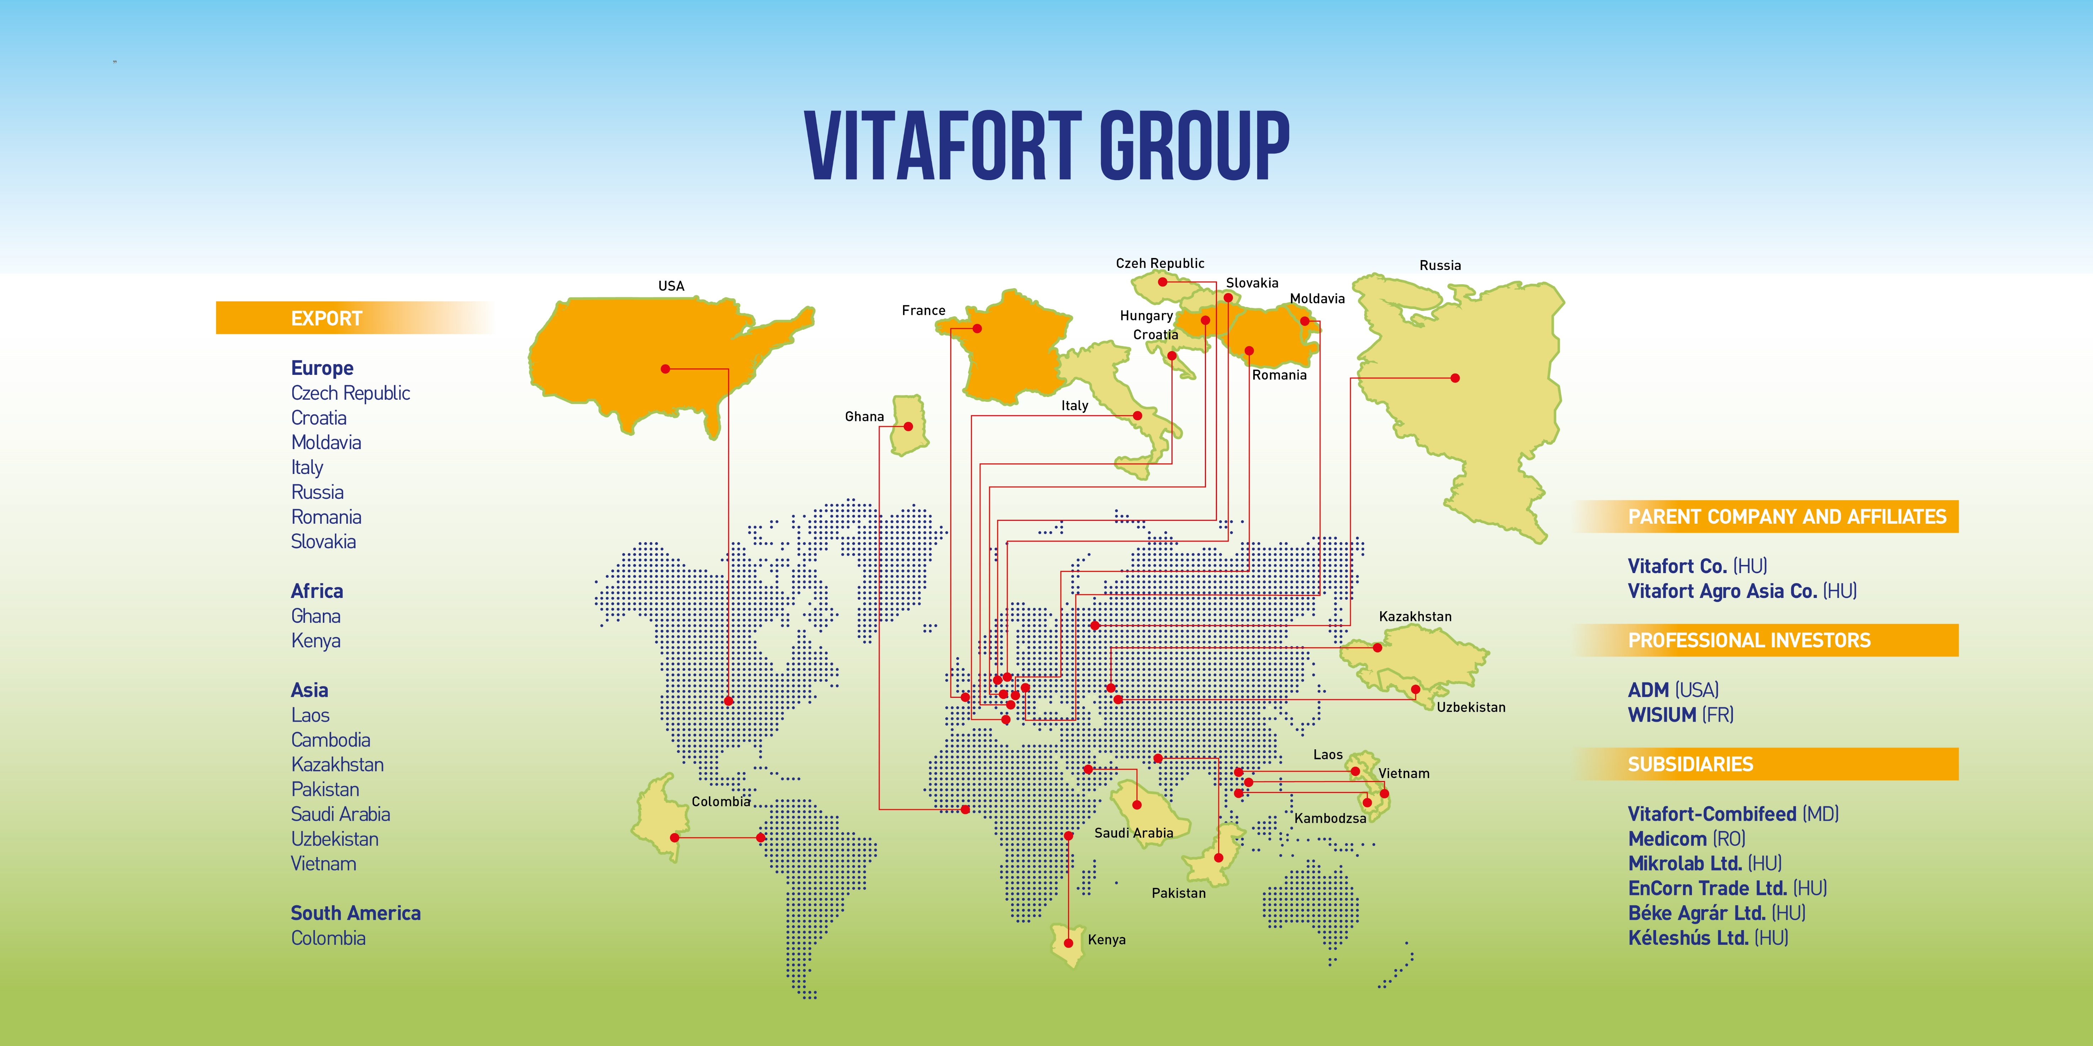

Slide 17
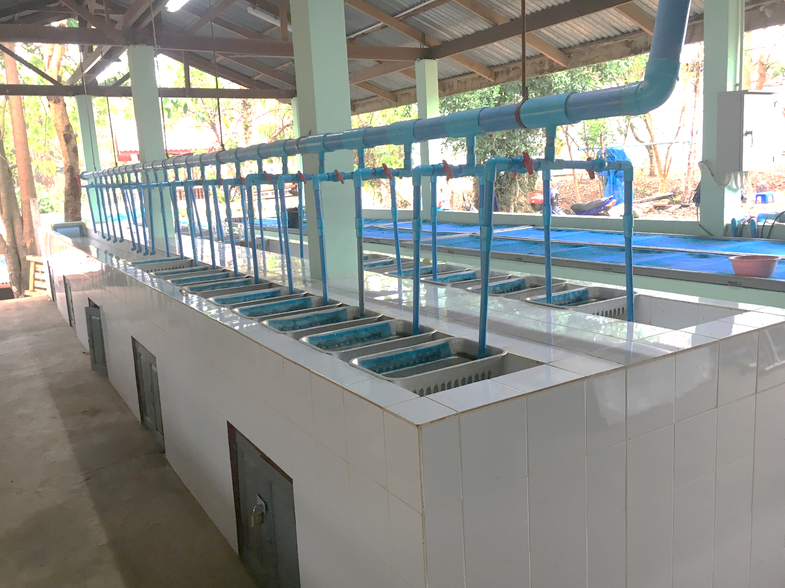
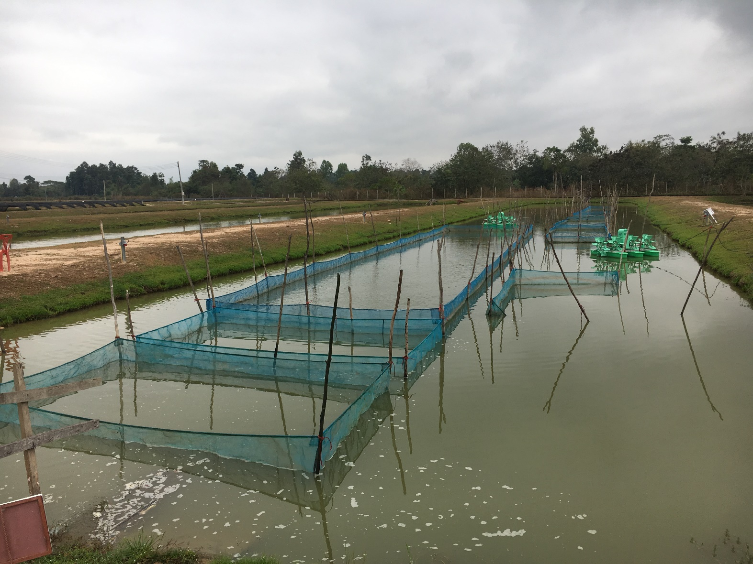
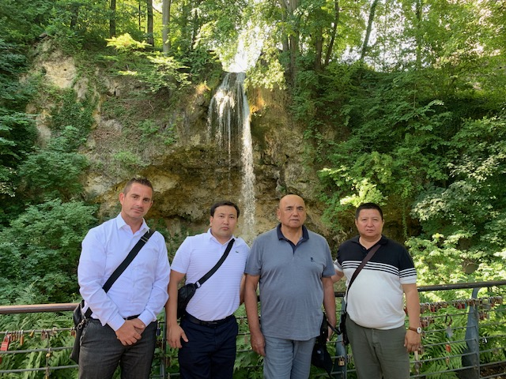
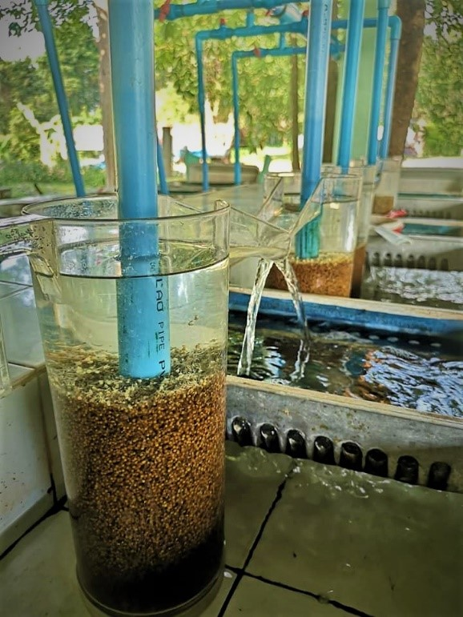
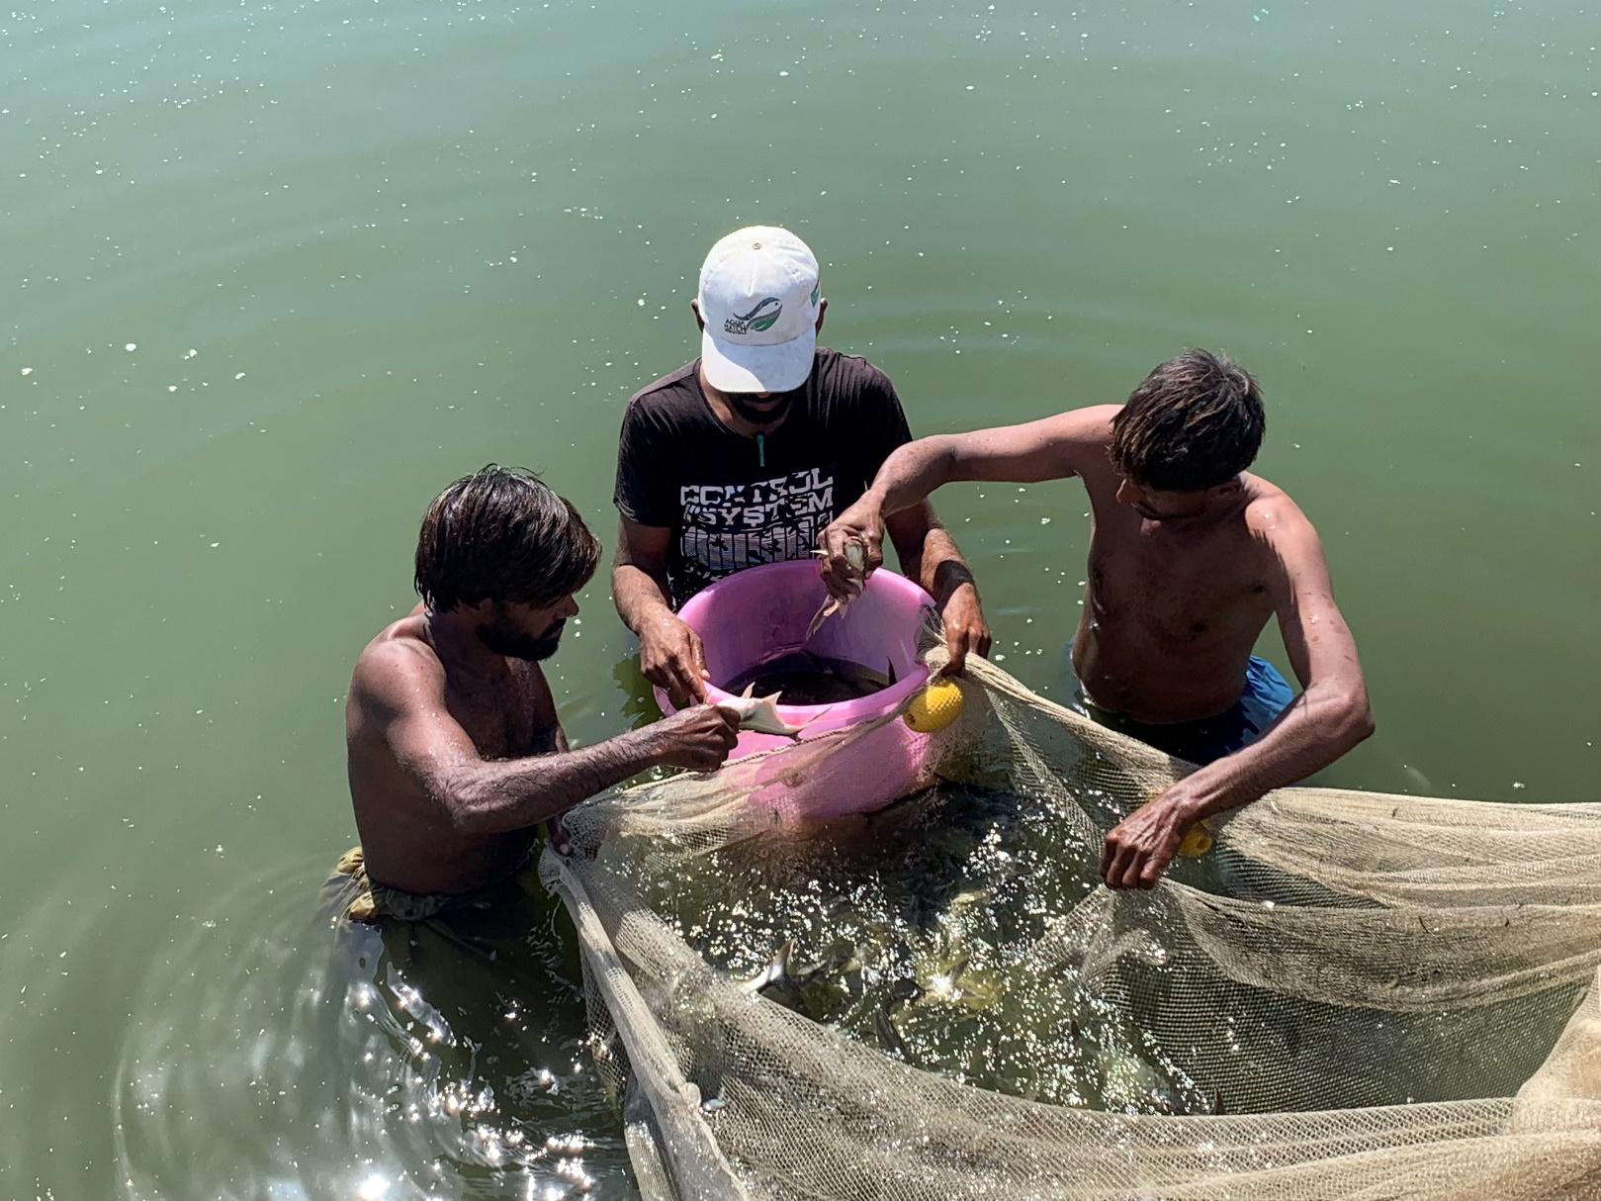
International cooperations in aquaculture
Vietnam: Cooperation with MAVIN Co. (fish feed production)
Columbia: Reconstruction of governmental fish farm
Pakistan: Aquahatch Co., Marinehatch Co.: JV companies for fresh water fish and shrimp production

